Slide 1
Programming
Extending functionality

Slide 2
Outline
Where is the database?
Where do the programs work?
Sequences and substitution variables
Declaring variables
Verbose syntax IF…THEN...ELSE...END IF;

Slide 3
Where is the database?
The database is at the base of your application
When you look at a software schematic, the data is almost always at the opposite end to the user.

Slide 4
Application layers
The presentation layer
  The user sees or interacts with this layer.
The business logic layer
  Enforces the business rules
The data access layer enforces rules regarding the storage and access of information.
Presentation Layer
Business Layer
Data access layer

Slide 5
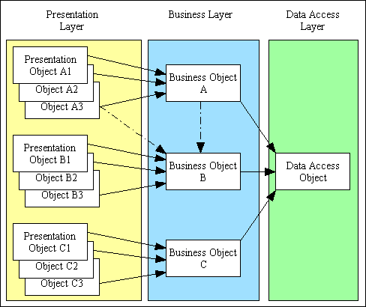
Databases in an application
User
Data base
Notes:
Business logic describes the sequence of operations associated with data in a database to carry out the business rule.
There may be multiple presentation layers. How many ways can you think of to access your bank account? Your timetable? Your results? Webcourses?
How many versions of the data are there?

Slide 6
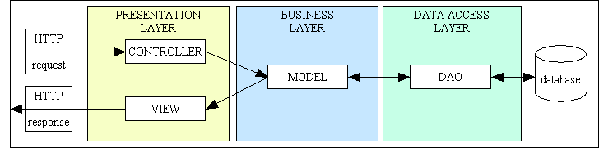
Over the web
User
Data base

Slide 7
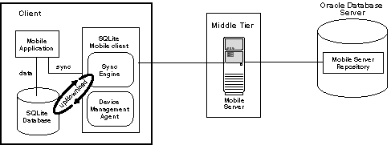
Apps use multiple databases…
Data base
User
Data base

Slide 8
Programming
Enables:
  Taking data from the user.
  Showing results to the user.
  Making decisions based on our data and then adding further processing.
  Exiting safely if something goes wrong.
Inhibitor:
  The programs are compiled, so they have limited memory, restricting what can be selected.

Slide 9
Structure of a program
A PL/SQL program has a very rigid structure:
A declaration section
An executable section
An exception section
  ..possibly.
Declarea
Begin
End;
Exception

Slide 10
Declaration section
Every operand considered by the program must be declared here.
Normal datatypes apply e.g.
  v_capacity integer;
Operands can inherit attribute types e.g.
  v_sno p_student.studentno%TYPE;
  v_sno takes the type studentno has.

Slide 11

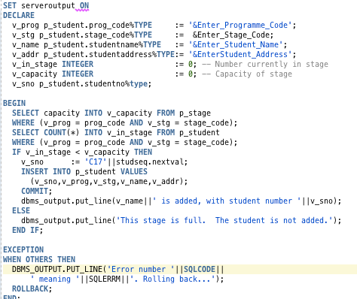
User to database
A database is a back-end product
The program is in the database
we will use a ‘crowbar’ method to get data from and to the user.
Input crowbar:
  Substitution variable
Output crowbar:
  DBMS_OUTPUT to SERVEROUTPUT

Slide 12
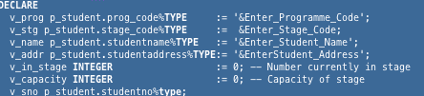
Input crowbar
Use substitution variables to get data in
These are all populated at the start of execution, like passing a parameter.

Slide 13
Syntax
This declares the operand v_prog.
v_prog is the same datatype as the prog_code attribute in the table p_student.
:= is an assignment operator.
The substitution variable starts with & and prompts the user with whatever follows it. It then substitutes the string where the & was.
All code lines end with a semi-colon ;

Slide 14
Declaration section
Starts with DECLARE and ends at BEGIN
This example prompts the user 4 times, once for each substitution variable.
There are also some local variables.

Slide 15
Notifying the user
Output crowbar:
  DBMS_OUTPUT to SERVEROUTPUT
Tell the program where you want the output to go
SET SERVEROUTPUT ON

Slide 16
DBMS_OUTPUT.PUT_LINE
This procedure prints a string on the SERVEROUTPUT
To see the output in your session
  SET SERVEROUTPUT ON
To display a sentence, concatenate
v_name||' has student number '||v_sno

Slide 17
The other sections
The Executable section starts with BEGIN and ends with END;
This is where the logic is executed.
If everything goes as planned, this is the only section that is executed.
The EXCEPTION section only acts on failure.

Slide 18
EXCEPTIONS
Exceptions only occur when:
  A SQL statement fails
    Failing is not the same as returning nothing.
  The program explicitly raises an exception.
Exceptions can be named.
  For the moment, we will treat them all the same
  We will return the code and error message that Oracle has thrown.

Slide 19

Exceptions
The catchall exception is WHEN OTHERS
This statement tells the program to display the error message on the SERVEROUTPUT and rollback any work done.

Slide 20
Adding a student
We have 3 tables:
  P_programme( prog_code, prog_name, prog_chairperson)
  P_stage (prog_code*, stage_code, mentor, capacity)
  P_student (studentno, (prog_code, stage_code)*, studentname, studentaddress)

Slide 21
Adding a student
Logic
  Get the programme code, stage, student name and address from the user.
  Select the capacity in the programme stage
  Count the number of students already enrolled
  If there is room,
    Generate a new student number
    Add the student and make it permanent
  Report back the (student number and) status.

Slide 22
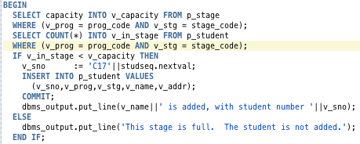
The Executable section

Slide 23
SELECTS in a program
Because the program has been allocated a rigid amount of memory, the results of the SELECT statement must go into an operand:
Notice that the SELECT statement returns a single value which is stored in the variable v_capacity.

Slide 24

IF…THEN...END IF;
The selection syntax is verbose and very particular.
If you get the syntax wrong, the error is not easy to understand.
I amended the program by taking out the space in END IF

Slide 25
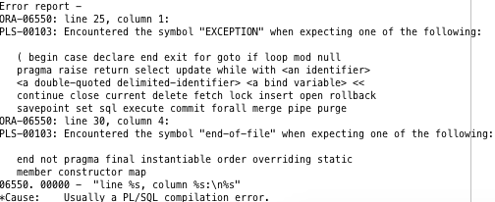
IF…THEN...END IF;
The resulting error was:

Slide 26
The whole program
SET serveroutput ON
DECLARE
v_prog p_student.prog_code%TYPE := '&Enter_Programme_Code';
v_stg p_student.stage_code%TYPE := &Enter_Stage_Code;
v_name p_student.studentname%TYPE := '&Enter_Student_Name';
v_addr p_student.studentaddress%TYPE:= '&EnterStudent_Address';
v_in_stage INTEGER := 0; -- Number currently in stage
v_capacity INTEGER := 0; -- Capacity of stage
v_sno p_student.studentno%type;
BEGIN
SELECT capacity INTO v_capacity FROM p_stage
WHERE (v_prog = prog_code AND v_stg = stage_code);
SELECT COUNT(*) INTO v_in_stage FROM p_student
WHERE (v_prog = prog_code AND v_stg = stage_code);
IF v_in_stage < v_capacity THEN
v_sno := 'C17'||studseq.nextval;
INSERT INTO p_student VALUES
(v_sno,v_prog,v_stg,v_name,v_addr);
COMMIT;
dbms_output.put_line(v_name||' is added, with student number '||v_sno);
ELSE
dbms_output.put_line('This stage is full. The student is not added.');
END IF;
EXCEPTION
WHEN OTHERS THEN
DBMS_OUTPUT.PUT_LINE('Error number '||SQLCODE||
' meaning '||SQLERRM||'. Rolling back...');
ROLLBACK;
END;

Slide 27
Builder2; Display customer
Declare…
-- Accept a customer number from user
Begin...
-- Select the customer’s name and address and display them
Exception
-- What if there’s no such customer?
End;

Slide 28
Tutorial
Record a new customer order on the BUILDER2 schema, allowing only one order line.

